Slide 1
SUPPLY AND DEMAND THEORY (PART 1)
DEMAND

Slide 2
What is Demand?
Demand: The willingness and ability of buyers to purchase different quantities of a good at different prices during a specific time period.
I may demand that I will pay $4 for each magazine, and buy 10 magazines in a month
Or I may demand that I will pay $3 for each magazine, and buy 15 magazines in a month
In both cases if I am willing to buy, but I don’t have the money to buy, am I a buyer?
In both cases if I have money to buy, but I don’t feel like buying, am I a buyer?

Slide 3
The Law of Demand
The Law of Demand states that as the price of a goods rises, the quantity demand of the good falls, and as the price of a good falls, the quantity demanded of the good rises, ceteris paribus.
In other words, the law of demand states that the price of a good and the quantity demanded of the good are inversely related, ceteris paribus.
What does this imply about the slope of the demand curve?
Do the terms quantity demand and demand mean the same thing?

Slide 4
The law of Demand (Cont)
Ceteris Paribus: A Latin term meaning “all other things constant” or “nothing else changes”.
Four ways to Represent Law of Demand
In words
In symbols
In a demand schedule.
As a demand curve.
Definition of a Demand Curve: A downward-sloping demand curve is a graphical representation of the inverse relationship between price and quantity demanded, specified by law of demand.

Slide 5
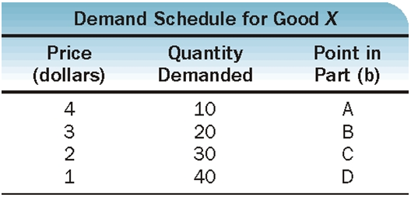
Can you Plot This?
What do we know about the slope? Is it upward sloping or downward sloping?
What do we know about the linearity of the line? Straight line or curve?

Slide 6
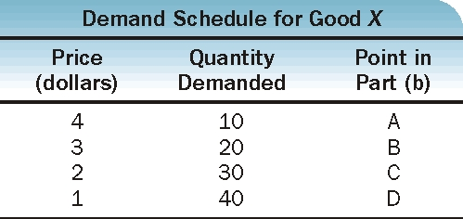
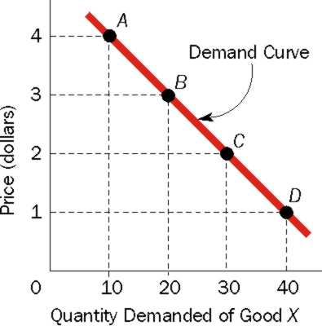
Exhibit 1 Demand Schedule and Demand Curve
(a)
(b)

Slide 7
Two Prices: Absolute and Relative
It provides a way of identifying and putting a number on opportunity costs.
Absolute Price: The price of a good in money terms. Example: Let the absolute price of a car be $30,000 and the absolute price of a computer be $2000.
Relative Price: The price of a good in terms of another good.
Why is the relative price? Can we interpret this?
What happens to the relative price of a good when absolute prices increases and ceteris paribus?

Slide 8
Why does Quantity Demanded Go Down as Price Goes Up?
We know that they are inversely related. Do we know WHY this is so?
There are two reasons:
People substitute lower priced goods for higher priced goods
Law of Diminishing Marginal Returns: For a given time period, the marginal (additional) utility or satisfaction gained by consuming equal successive units will decline as the amount consumed increases.

Slide 9
Individual Demand Curve and Market Demand Curve
Individual Demand Curve: It represents the price-quantity combinations of a particular good for a SINGLE buyer.
Market Demand Curve: It represents the price-quantity combinations of a particular good for ALL buyers.
A Market demand curve is derived by “adding up” individual demand curves.

Slide 10
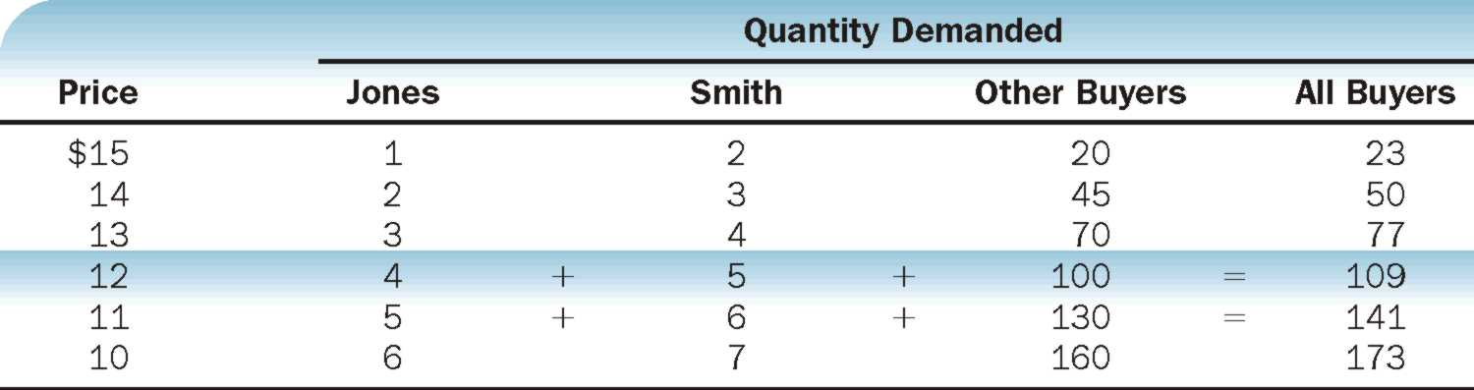
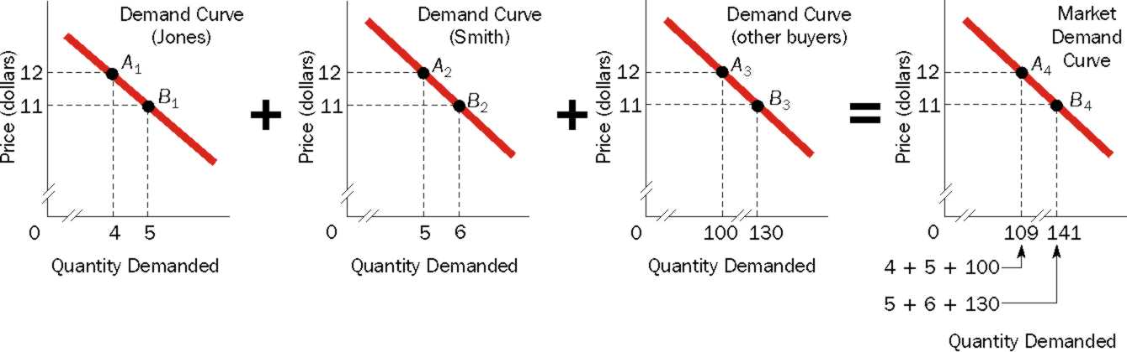
Exhibit 2 Deriving a Market Demand Schedule and a Market Demand Curve
(a)
(b)

Slide 11
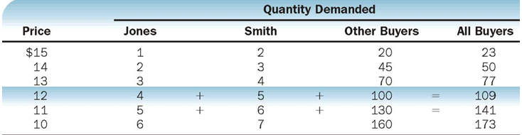
Lets Do Try the First two Lines to find and draw Market Demand
Draw the market demand curve.

Slide 12
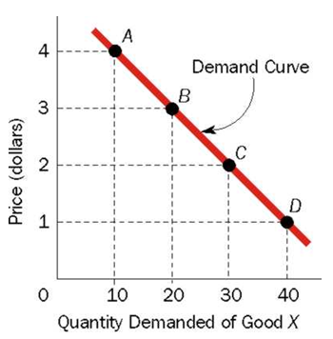
A Change in Quantity Demanded Vs a Change in Demand
CHANGE IN QUANTITY DEMANDED:
Say demand falls from 20 units to 10 units because price increased from $3 to $4.
Is this a change in quantity demanded or change in demand?
A movement from one point to another point on the same demand curve caused by a change in the price of the goods ➔ Change in quantity demanded

Slide 13
Change in Demand
Demand is represented by the entire curve. Therefore, if there is a change in demand ➔ shift in the entire curve.
Demand can increase or decrease. Look at the following schedule:
Price
Price | Quantity Demanded
20 | 500
15 | 600
10 | 700
5 | 800

Slide 14
Increase in Demand
In means that individuals are willing and able to buy more units of the good at each and every price.
Let’s plot this.
Which way does the curve shift?
Price | Quantity Demanded (old) | Quantity Demanded (new)
20 | 500 | 600
15 | 600 | 700
10 | 700 | 800
5 | 800 | 900

Slide 15
Decrease in Demand
In means that individuals are willing and able to buy less units of the good at each and every price.
Let’s plot this.
Which way does the curve shift?
Price | Quantity Demanded (old) | Quantity Demanded (new)
20 | 500 | 400
15 | 600 | 500
10 | 700 | 600
5 | 800 | 700

Slide 16
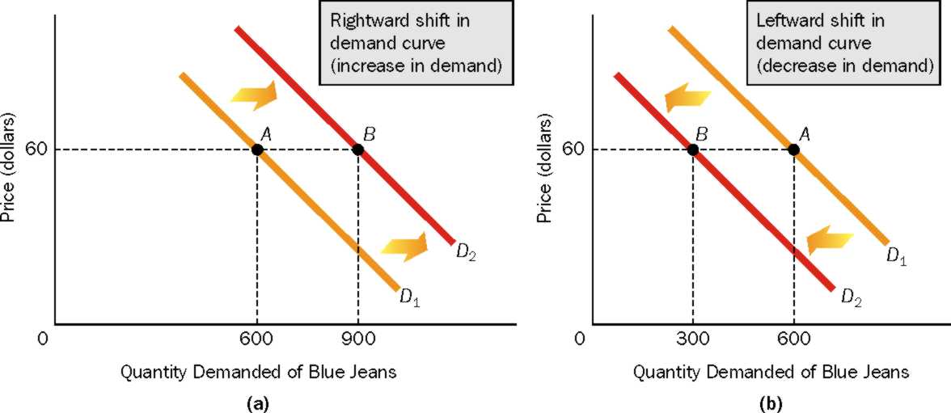
Shifts in the Demand Curve

Slide 17
What Factors Cause the Demand Curve to Shift?
Income
Preferences
Prices of Related Goods
Number of Buyers
Expectations of Future Prices
Lets look at how each affect demand…

Slide 18
What Factors Cause the Demand Curve to Shift? (CONT)
INCOME: As a person’s income changes (increases or decreases), his or her demand for a particular good may rise, fall or remain constant.
Normal Good: A good the demand for which rises (falls), as income rises (falls). Example?
Inferior Good: A good the demand for which falls (rises), as income rises (falls). Example?
Neutral Good: A good the demand for does not change as income rises or falls. Example?

Slide 19
What Factors Cause the Demand Curve to Shift? (CONT)
PREFERENCES: People’s preferences affect the amount of a good they are willing to buy at a particular price
A change in preference AWAY from a good (example: NORMAL JEANS) ➔ Demand Fall ➔ Demand shifts LEFT
A change in preference IN FAVOUR of a good (example: TORN JEANS) ➔ Demand Rises ➔ Demand shifts RIGHT.

Slide 20
What Factors Cause the Demand Curve to Shift? (CONT)
PRICES OF RELATED GOODS: There are two types.
Substitutes: Two goods that satisfy similar needs or desires. If two goods are substitutes, the demand for one good rises as the price of the other good rises (or the demand for one good falls as the price of the other good falls). Example?
Complements: Two goods that are used jointly in consumption. If two goods are complements, the demand for one rises as the price of the other falls, (or, the demand for one falls as the price of the other rises). Example?

Slide 21
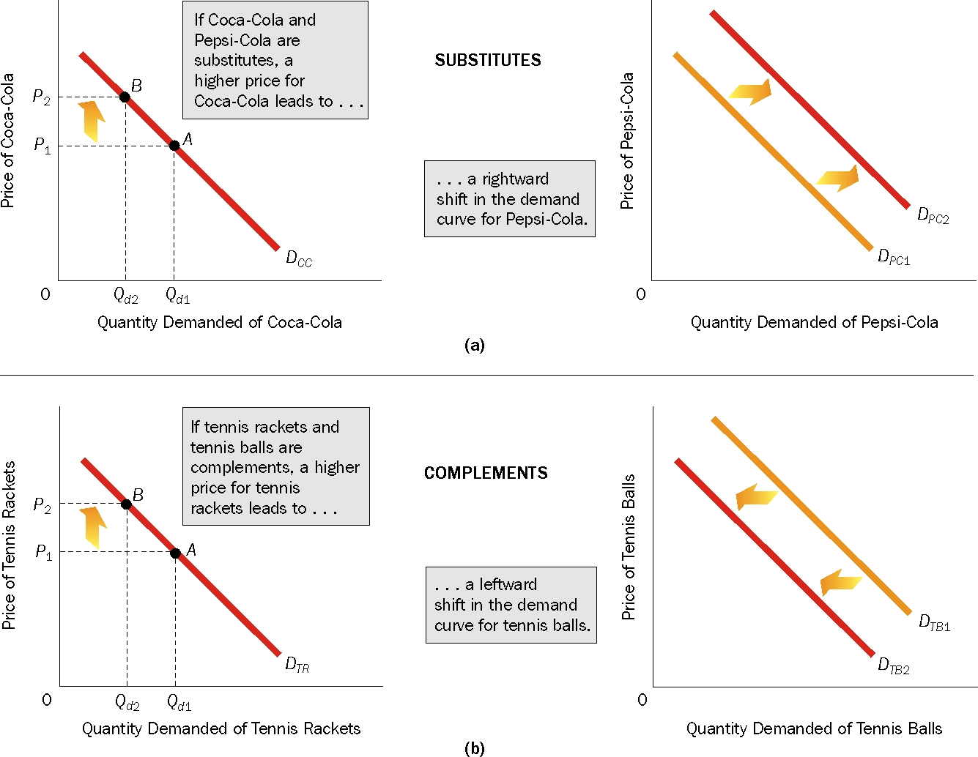
What Factors Cause the Demand Curve to Shift? (CONT)

Slide 22
What Factors Cause the Demand Curve to Shift? (CONT)
NUMBER OF BUYERS:
The demand for a good in a particular market area is related to the number of buyers in the area.
Buyers ➔ Demand ➔ Demand Shifts right
Can be caused by:
Higher Birth rate
Increased immigration
Migration in the region
Buyers ➔ Demand ➔ Demand Shifts left
Can be caused by:
Higher Death rate
Migration out of the region

Slide 23
What Factors Cause the Demand Curve to Shift? (CONT)
EXPECTATIONS OF FUTURE PRICES:
Expect prices ➔ Current Consumption ➔ Demand Shifts RIGHT.
Example? Houses, iPhones?
Expect prices ➔ Current Consumption ➔ Demand Shifts LEFT.
Example?

Slide 24
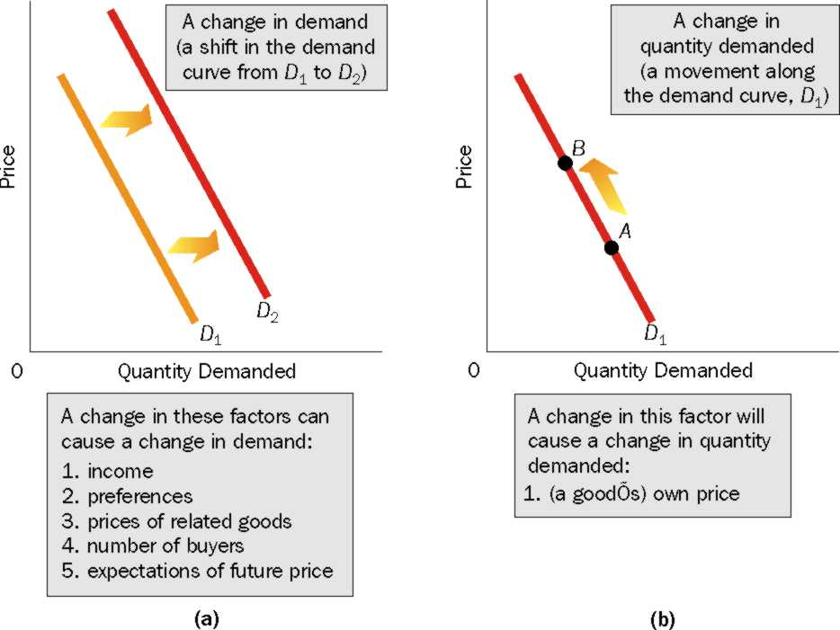
SUMMARIZING….

